Slide 1
127699

Slide 2
Introduction
CS 3339
Project 3 Cache Unit and stuff
Greg LaKomski
Texas State University
Fall 2019

Slide 3
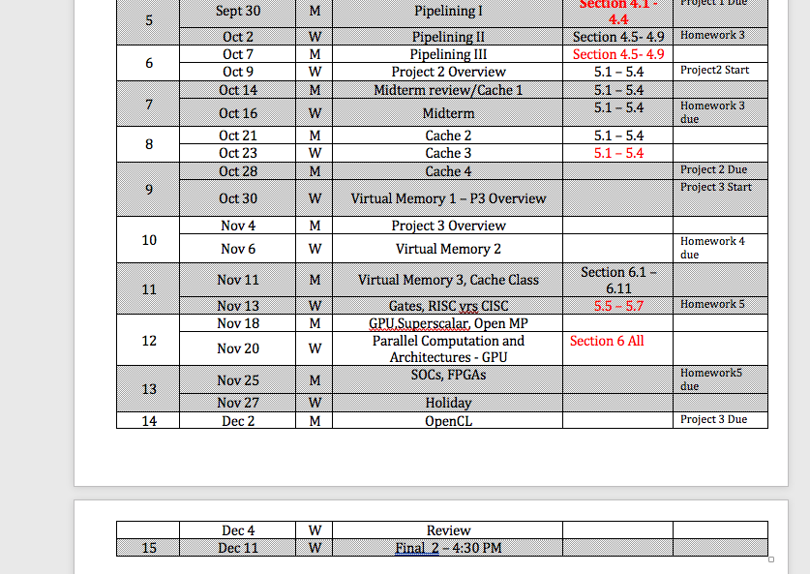
Schedule for Rest of Semester

Slide 4
Cache Description:
The cache is uniform (holds both data and instructions) and is a 2-way associative cache with 4 sets. Each cache line/block contains 2 data words (1 word = 32 bits = 4 bytes). All memory fetch operations will return two words . The cache is organized as follows:

Slide 5
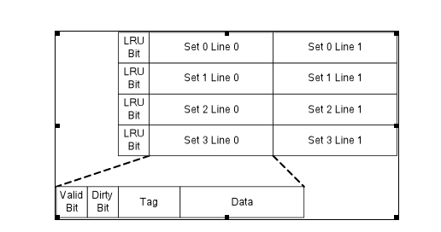
Cache Organization

Slide 6
CACHE
Note that since all address are word aligned , the lower two bits will be ignored when calculating which word will be written to in a cache block. Furthermore, since each cache line is 2 words wide, memory is effectively two word aligned, so the lower three bits of a memory address are ignored when calculating which cache set the data should be written to. The set index
EX 100 = 1100100 2 words x 4 bytes/block

Slide 7
CACHE
Since you have2 way cache you have two blocks in a set.
You have two words in a block
You have 8 bytes in a block or 3 bits worth
You have 4 sets cause I say so so you have 2 bits to tell you which set
Since all you care about is which set and which word in a block you ignore the last two bits. Actually, since you are using 96 + 8n,100 + 8n you really don’t need to decode even the word from bits! The first word is always “00”

Slide 8
CACHE
There are sufficient ports of cache so that the IF and MEM unit can access the cache at the same cycle without any port conflict. If the two units are accessing the same set at the same time, assume MEM will be executed at the first half of the cycle and IF will be executed at the second half of the cycle.
The point is that you can do both in a cycle so you can complete both activities

Slide 9
CACHE
Note that the IF unit can only execute 1 memory read per cycle. Therefore, if the IF unit is attempting to fetch the instructions 100 and 104, and neither are in cache, then a memory read for the words at address 96 and 100 can be initiated. The memory read for the words at addresses 104 and 108 must be initiated during the next clock cycle.

Slide 10
CACHE
All the bits will be initialized as 0.
The LRU bit is initialized to 0 also which means it is LRUsed. A one(1) is set when the block is used so 1 means MOST recently used.
#one lru bit for set - ??? ONE BIT ??? lruBit = [0,0,0,0]
NOTE: Since we only have 2 blocks I set bit to 1 to mean block 0 was MRU and to 0 when block 1 is written or read and is MRU

Slide 11
Valid Bit
When a valid line exists, the valid bit will be turned on (set to be 1).
The dirty bit will be turned on when the pipeline writes to any part of the line.
You never will WRITE to an instruction word, but you must be cognizant of crossing the line between instructions and data. Since you always fetch 2 words from memory it is possible to have an <instruction>,<data> block. But you would only write and update word 1

Slide 12
CACHE
The write-back from cache to main memory takes no time (for simplification).
All dirty blocks will be written back at the cycle the simulation is finished.

Slide 13
MY CACHE DESIGN
cacheSets = [ [ [0,0,0,0,0], [0,0,0,0,0] ], [ [0,0,0,0,0], [0,0,0,0,0] ], [ [0,0,0,0,0], [0,0,0,0,0] ], [ [0,0,0,0,0], [0,0,0,0,0] ] ]
# valid, dirty, tag, data, data
#one lru bit for set - ??? ONE BIT ??? lruBit = [0,0,0,0]
tagMask = 4294967264 # -> 11111111111111111111111111100000
setMask = 24 # -> 0000000000000000000000000011000
justMissedList = [] # as it implies address's that resulted from cache misses

Slide 14
MY Check CacheFUNCTION
def checkCache( self, dataIndex, instructionIndex, isWriteToMem, dataToWrite ):
Based on what I am doing I pass different indexes:
If I am passing an instruction index, pass -1 for the data index. This way I can easily tell by checking the “ -1” if I am dealing with an instruction.
This allows me to use different functions to calculate the different addresses and makes it clear when I am dealing with the instruction / data boundary. It just the way my code does it.

Slide 15
First step is to figure out the address of either the instruction or the data location.
# calculate the memory address from instruction index and base address if( dataIndex == -1): #it is an instruction we are getting the address for addressLocal = 96 + ( 4 * instructionIndex ) # correct
#if its a data location do this else: addressLocal = 96 + (4 * (self.numInstructions) ) + (4 * dataIndex)

Slide 16
Then I figure out the correct addresses for the two words taking into account the alignment.
if addressLocal % 8 == 0: dataWord = 0 # block 0 was the address address1 = addressLocal address2 = addressLocal + 4
if addressLocal % 8 != 0:
dataWord = 1 # block 1 was the address
address1 = addressLocal - 4
address2 = addressLocal

Slide 17
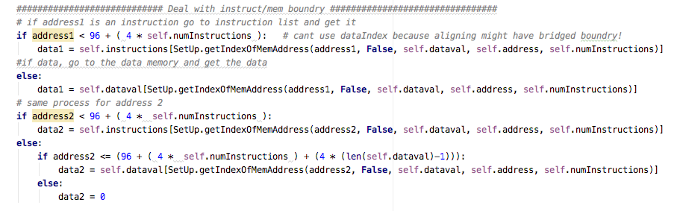
Check for Boundary Conditions

Slide 18
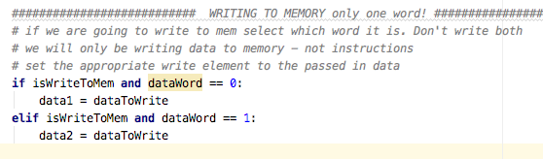
If Writing to Memory Eventually

Slide 19
Decode Address for Cache Check
setNum = (address1 & self.setMask) >> 3 tag = (address1 & self.tagMask) >> 5
ALL YOU CARE ABOUT IS THE FIRST WORD!

Slide 20
cacheSets[setnum][blocknum][wordnum]

Slide 21
2 way associative : 2 blocks : 2 words Cache size is 4 sets
cacheSets =
[
[ [0,0,0,0,0], [0,0,0,0,0] ], #set 0
[ [0,0,0,0,0], [0,0,0,0,0] ], #set 1
[ [0,0,0,0,0], [0,0,0,0,0] ], #set 2
[ [0,0,0,0,0], [0,0,0,0,0] ] #set3
]
# valid, dirty, tag, data, data

Slide 22
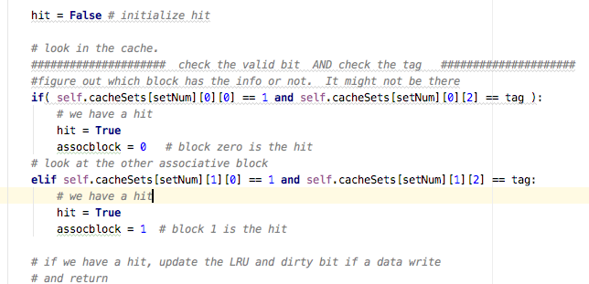
Check for a hit or miss
0 1 2 3 4
cacheSets[setnum][blocknum][valid, dirty, tag, data, data]

Slide 23
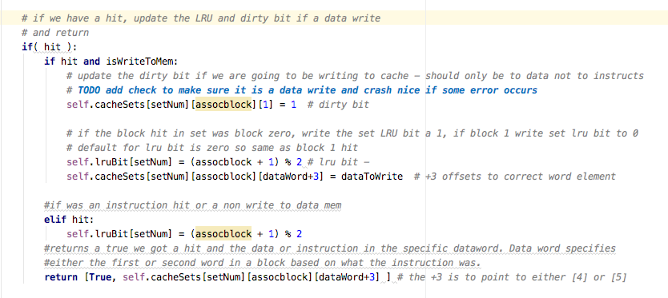
WE HAVE A HIT!

Slide 24
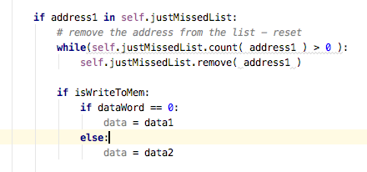
WE HAVE A MISS and ITS MISS # 2
If we get here, we have a CACHE MISS
First check to see if we had a miss for this address in the previous cycle so we can update the cache with the data in the requested mem address and allow the instruction to proceed
If we tried to get this address in the previous cycle and had a cache miss, its address is in the JustMissedlist therefore, we have waited one cycle, and now need to perform the memory operation

Slide 25
Get ready to write to cache
check the set number, block number based on lru bit setting, and dirty bit for the block number: if dirty bit is 1 we got a data to deal with
if the block in the set in cache we want to write to is dirty we will write data words in that block to memory before overwriting
if the lru bit for the set is zero, the set / blocks could be empty. If so then blocks dirty bit will certainly be 0: zero was the initialized value for the lry bit !
if the dirty bit is 1 then fine, write back both words in block. But it is also possible that block 1 is dirty. SO write it back too. If the lru bit is 1, then certainly the set/block is not empty and it is possible that block zero's dirty bit is 1. Then write back.
NOTE: we are getting the tag associated with the block that is being written back and set but we will write both blocks back if both blocks are on the data side. Take care of the case where you are across the boundry.

Slide 26
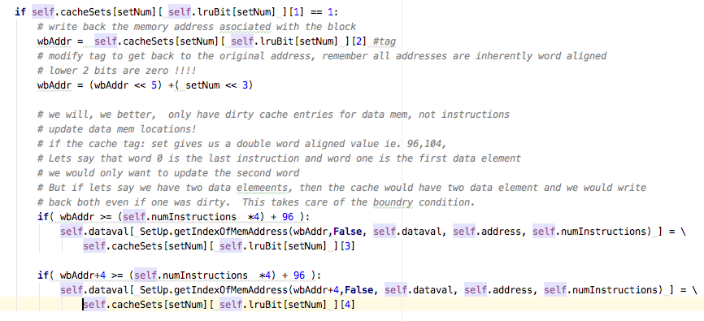
Memory Write Back IF NEEDED

Slide 27
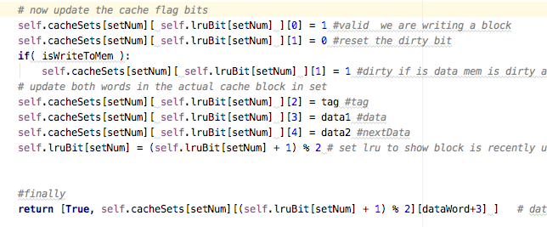
NOW WRITE CACHE
valid, dirty, tag, data, data

Slide 28
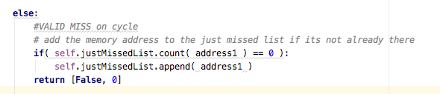
WE HAVE A MISS AND ITS # 1

Slide 29
I will put the cache class file up when I get home

Slide 30
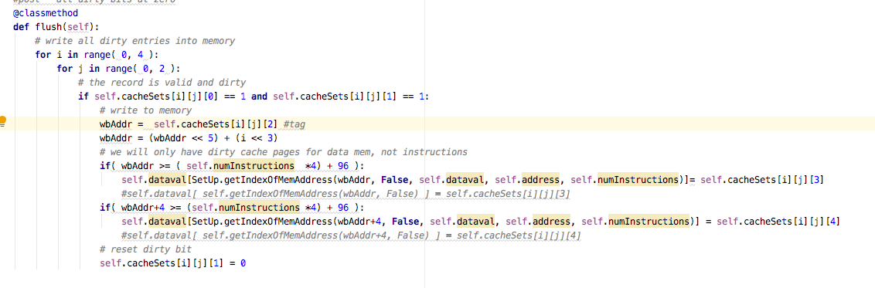
Flush in cache class

Slide 31
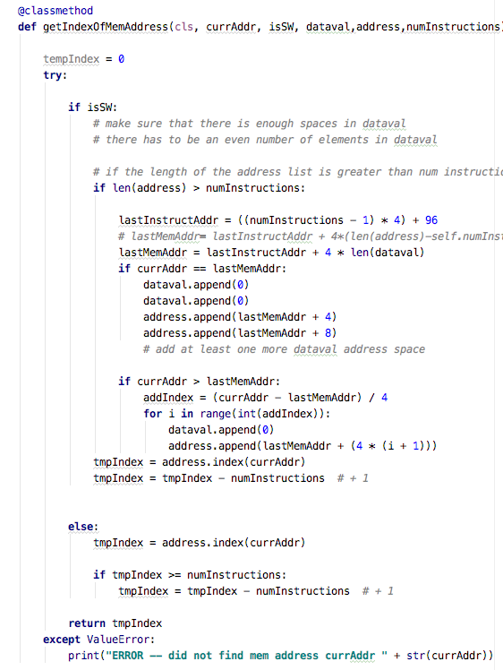
Added getIndexOfMemAddress to helpers

Slide 32
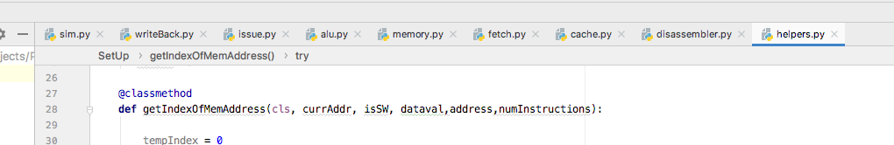
Files you need to code

Slide 33
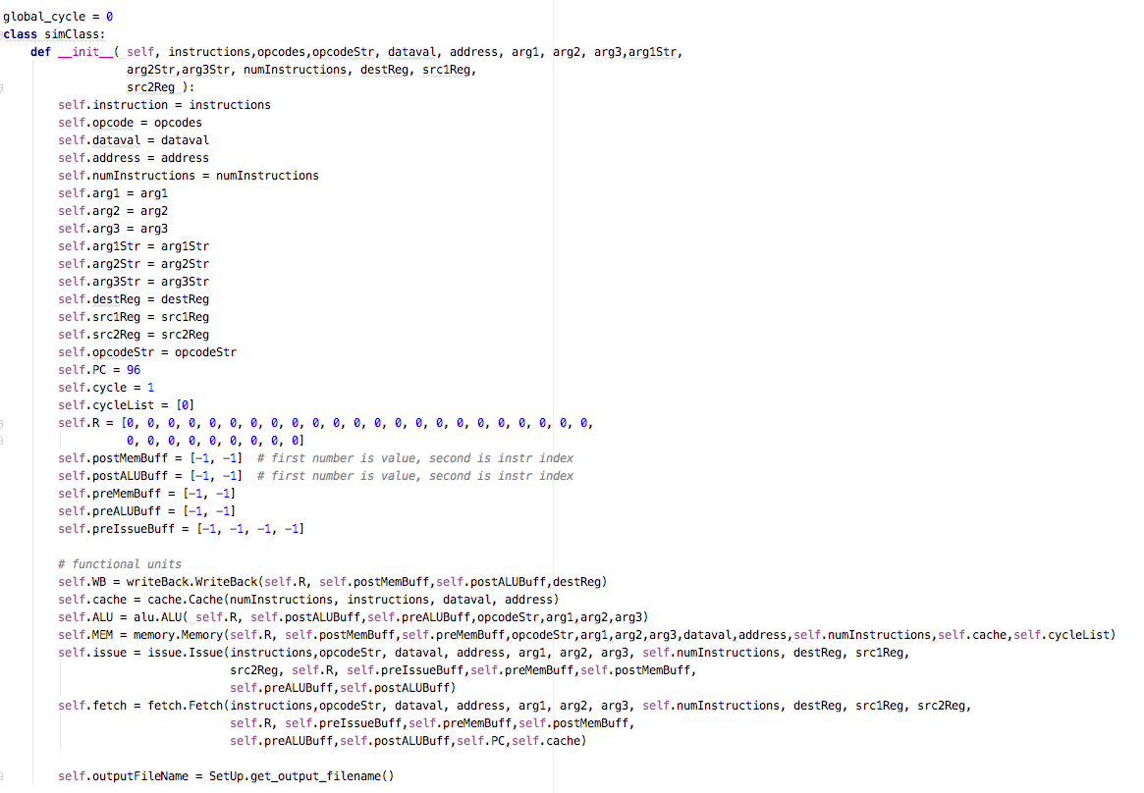
Start of sim class

